Slide 1

Toward a Multilayer Network Neuroscience of Cognition: Possible Promises and Probable Pitfalls
Ivan L. Simpson-Kent, PhD
Postdoc, Changing Brain Lab
Twitter: @IvanSimpsonKent

Slide 2

Outline of this Presentation
Part I
A network theory of cognition (intelligence)
Part II
A network neuroscience of g
Part III
An approach toward a multilayer network neuroscience of cognition
Part IV
Preliminary insights & cautions, and ways forward

Slide 3
Part I: A network theory of cognition (intelligence)

Slide 4
The positive manifold of cognitive ability
Performance on cognitive tasks are positively correlated with each other (Spearman, 1904).
But why is everything correlated?
 | Vocabulary | Math | Reading | Reasoning
Vocabulary | 1.00
Math | .35 | 1.00
Reading | .85 | .41 | 1.00
Reasoning | .67 | .73 | .52 | 1.00

Slide 5
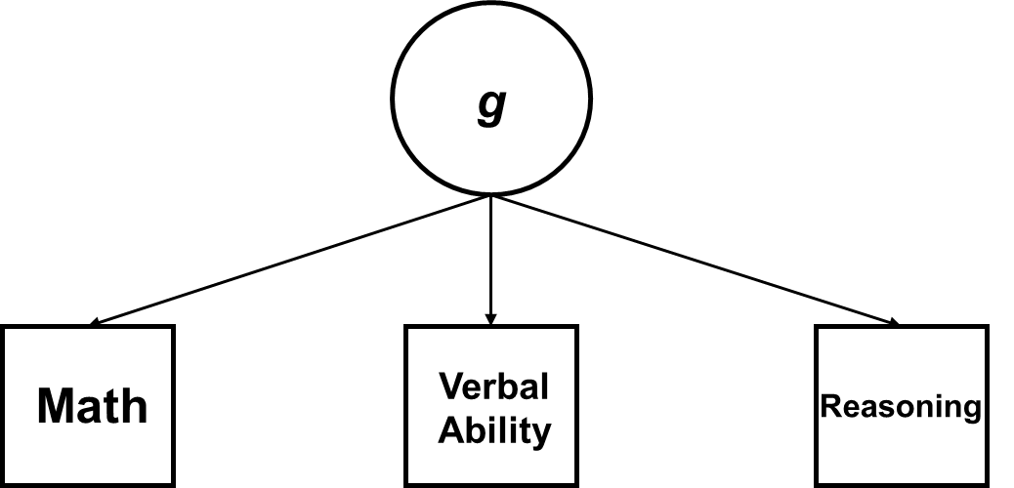
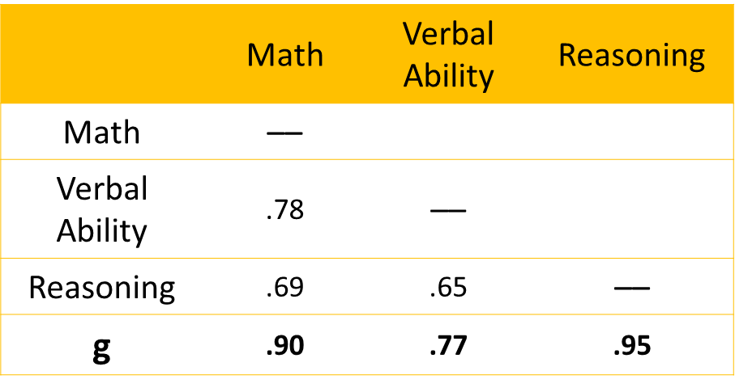
Spearman’s g-factor model
General factor
s_{m}
s_{v}
s_{r}
Specific factors
Spearman, 1904; 1927

Slide 6
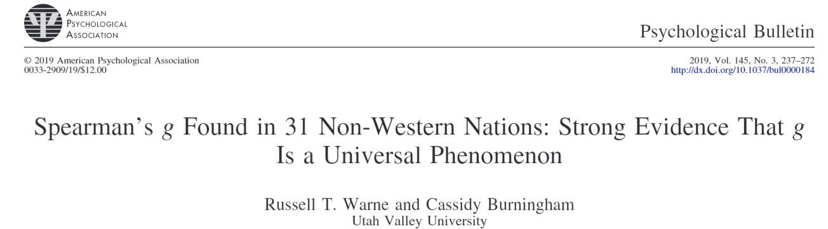
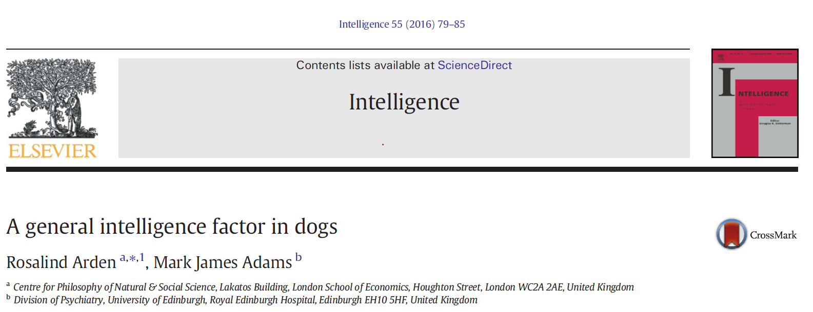

Slide 7
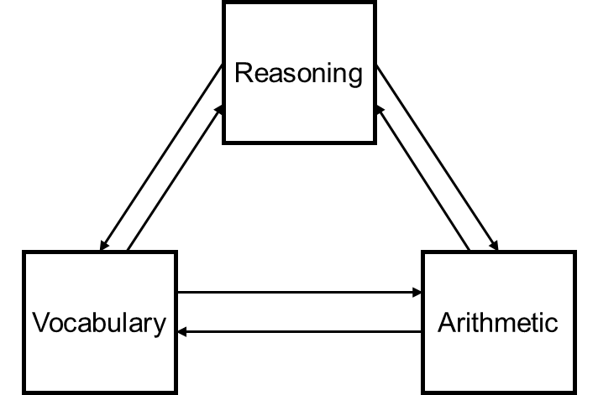
The Mutualism model
van der Maas et al., 2006

Slide 8
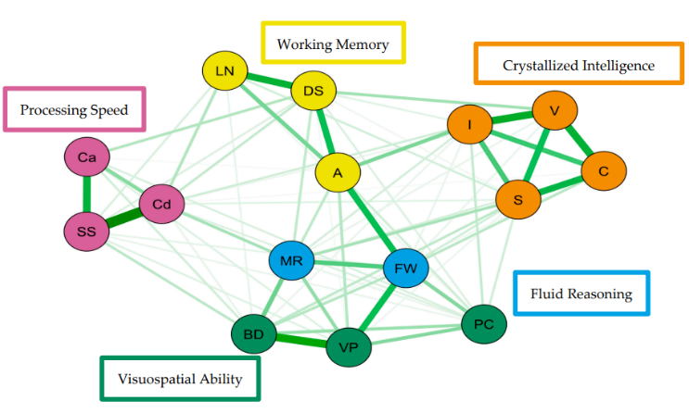
Cross-sectional support for mutualism
Nodes represent cognitive variables (e.g., reasoning) while edges indicate interactions (e.g., correlations) between nodes.
Schmank et al., 2019

Slide 9
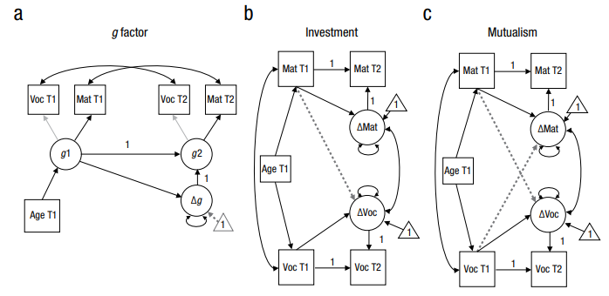
Longitudinal support for mutualism
Kievit et al., 2017

Slide 10
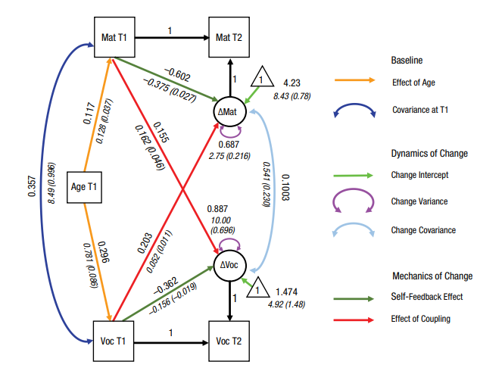
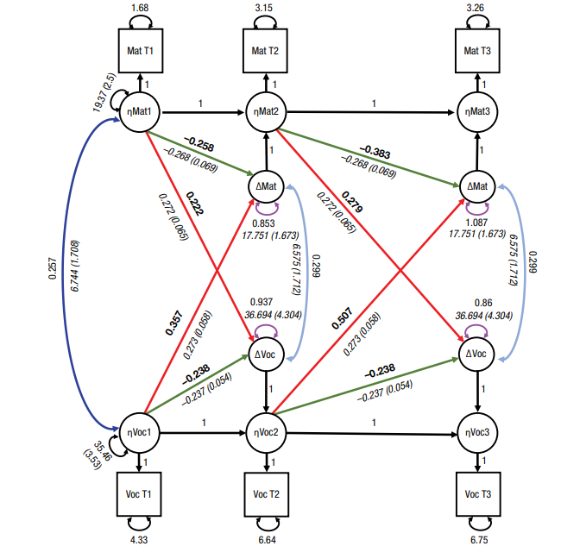
Longitudinal support for mutualism
Late Adolescence and Early Adulthood
Childhood
Kievit et al., 2017
Kievit et al., 2019

Slide 11
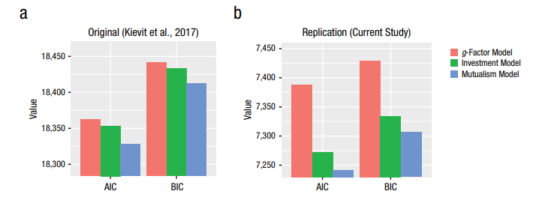
Longitudinal support for mutualism
Kievit et al., 2019

Slide 12
Part II: A network neuroscience of g

Slide 13
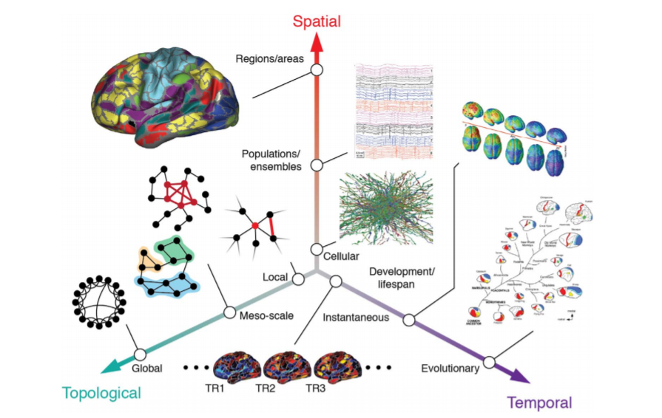
Network Neuroscience
Betzel and Bassett, 2017

Slide 14


Network Neuroscience
Notes:
https://mitp.silverchair-cdn.com/data/SiteBuilderAssets/Live/Images/netn/netn-1636384993.png

Slide 15
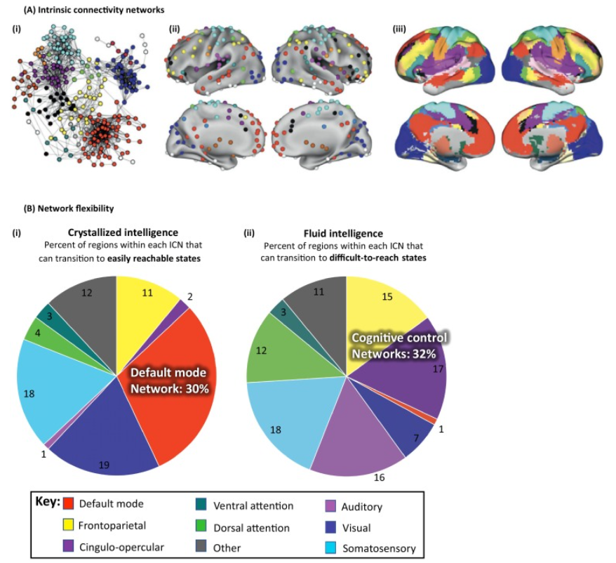
Network Neuroscience Theory of Human Intelligence
General intelligence (i.e., g) is an emergent, global network phenomenon that arises from the structure and dynamics of the brain.
Brain undergoes a tug of war between 'easy-to-reach' (those used to access prior knowledge needed to carry out crystallized tasks) and 'difficult-to-reach' (necessary for integrating information, giving rise to fluid-like cognitive abilities).
Barbey, 2018

Slide 16
Part III: An approach toward a multilayer network neuroscience of cognition

Slide 17
A multilayer network model of intelligence
Mutualism model
NNTHI

Slide 18
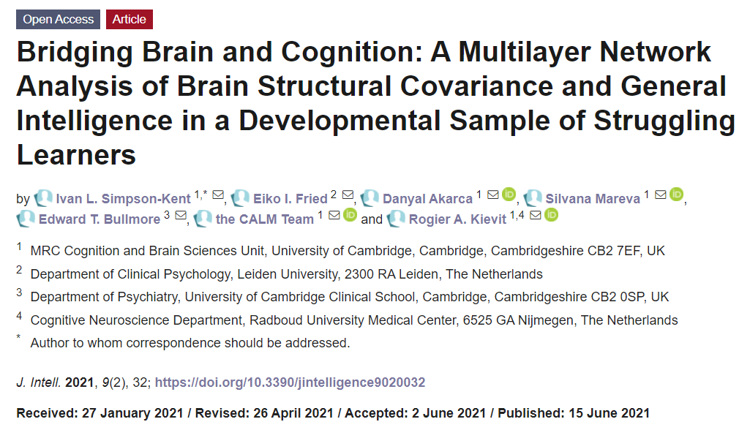
Notes:
https://www.mdpi.com/2079-3200/9/2/32

Slide 19
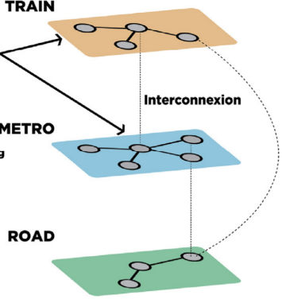
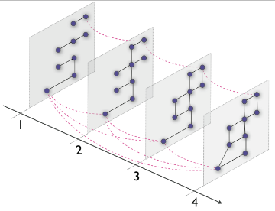
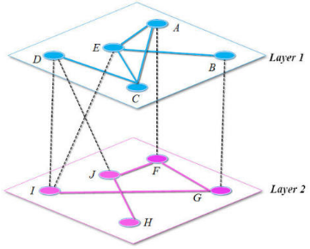
Types of multilayer networks
Multiplex
Multi-slice
Network of networks
Notes:
Asgari, Fereshteh, et al. "CT-Mapper: Mapping sparse multimodal cellular trajectories using a multilayer transportation network." Computer Communications 95 (2016): 69-81.
https://www.google.com/url?sa=i&source=images&cd=&ved=2ahUKEwjQrMi1-pfnAhXwDmMBHfErDZYQjRx6BAgBEAQ&url=http%3A%2F%2Fmucha.web.unc.edu%2Fnetworks%2F&psig=AOvVaw3dBDktadXwwmF5SvladO4v&ust=1579808219483876
Wang, Dingjie, and Xiufen Zou. "Control energy and controllability of multilayer networks." Advances in Complex Systems 20.04n05 (2017): 1750008.

Slide 20
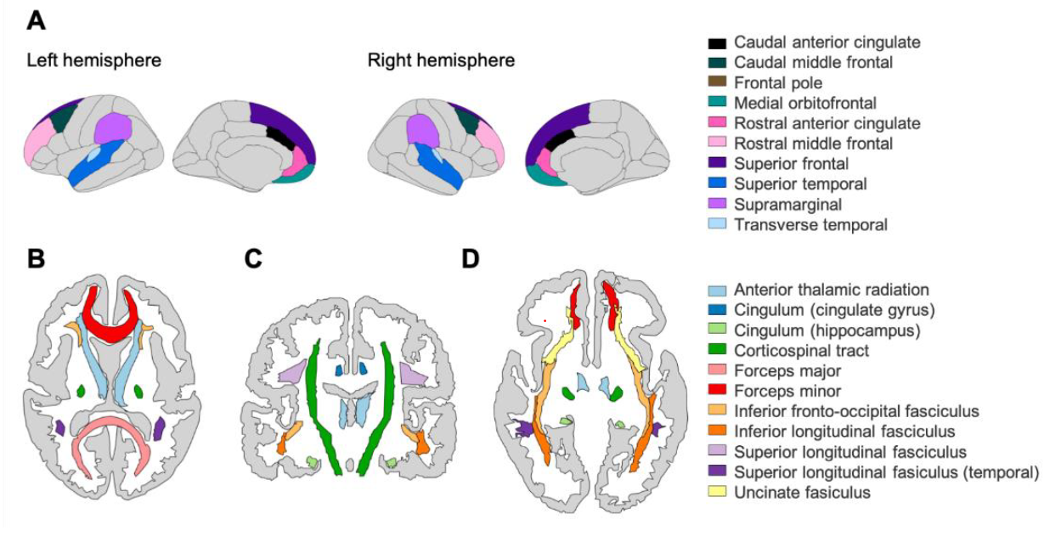
The CALM sample
Developmental (between 5 & 18 y.o.) sample of struggling learners: Centre for Attention, Learning and Memory (CALM, N = 805 cognition, 246 grey matter volume & 165 white matter fractional anisotropy).
Multilayer network

Slide 21
Network psychometrics
Phenomena (e.g., intelligence) are conceived as complex systems of interacting nodes (e.g., specific abilities and individual brain regions).
Permits the estimation of partial correlations (conditional dependence)
Community detection methods (i.e., Walktrap) can be used to discover clusters or modules of cognitive and neural nodes

Slide 22
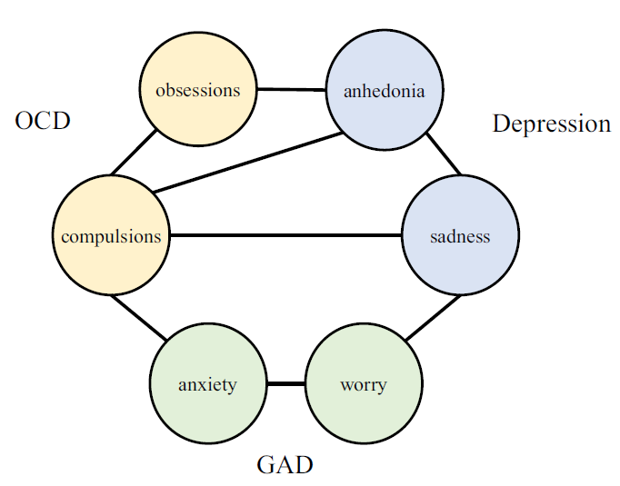
Centrality (bridge) strength
Originally developed to examine comorbidity.
Sums the strength of nodes between clusters/groups (e.g., brain and cognition).
Jones et al., 2019
Notes:
https://minimaxir.com/img/interactive-network/ggplot1.png

Slide 23
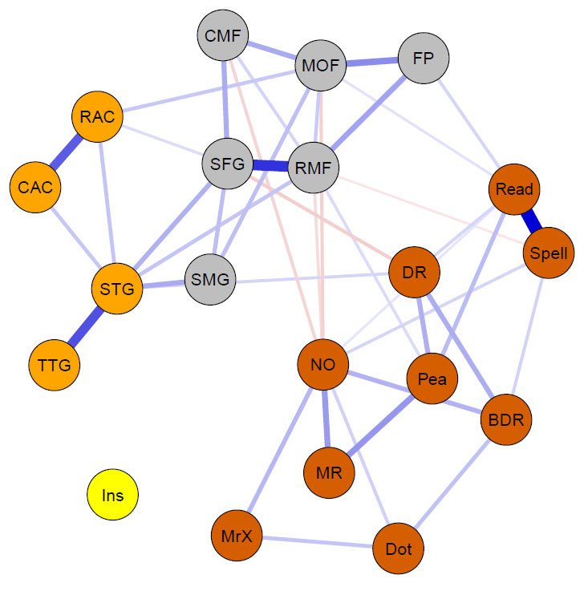
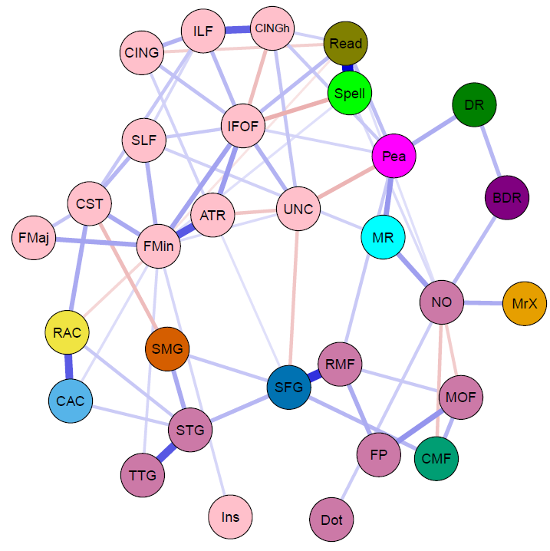
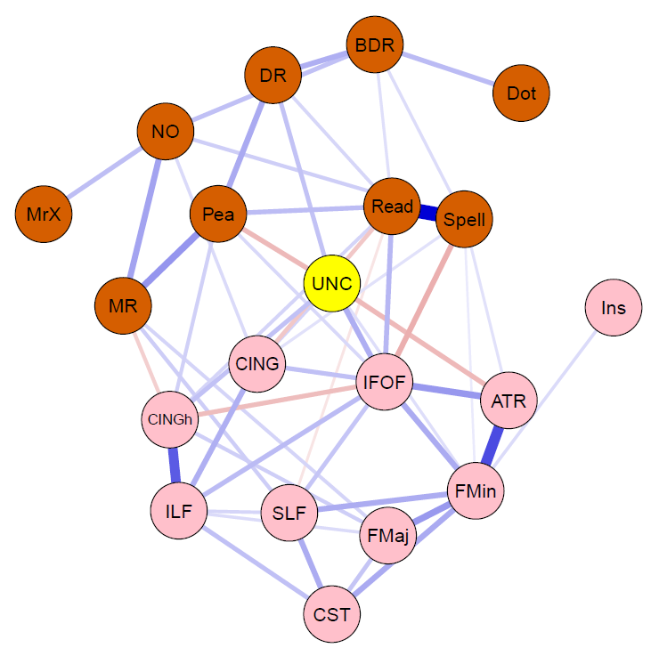
Cognition & GM
Bi-layer Network
Tri-layer Network
Cognition & WM
Bi-layer network

Slide 24
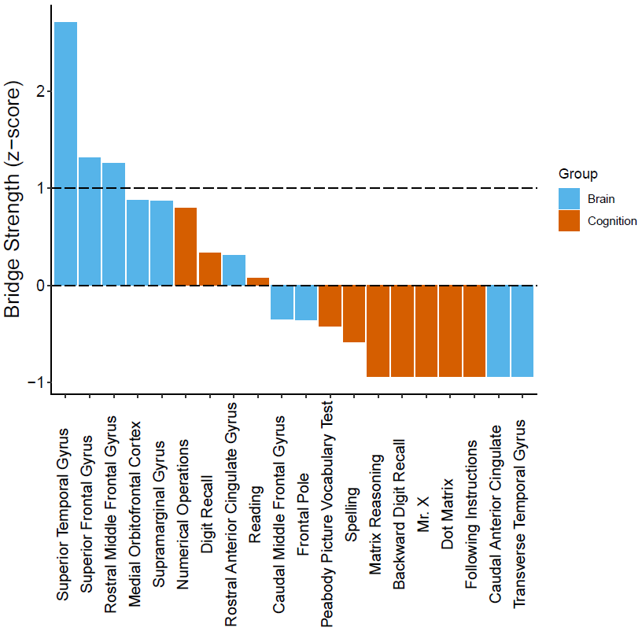
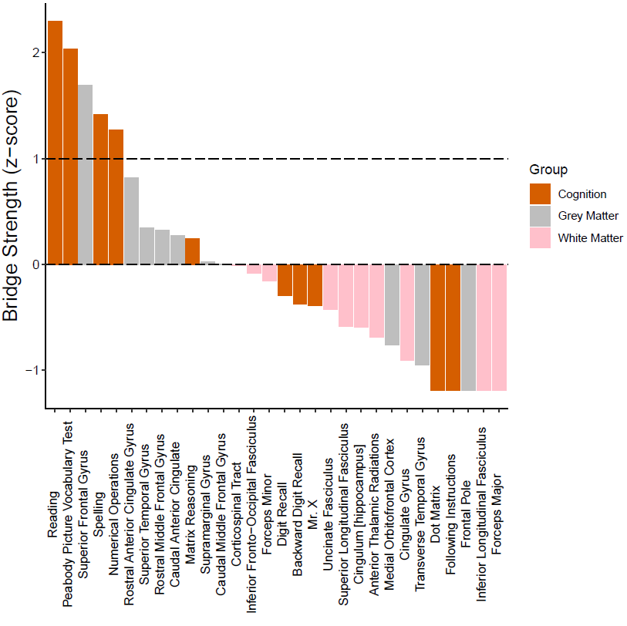
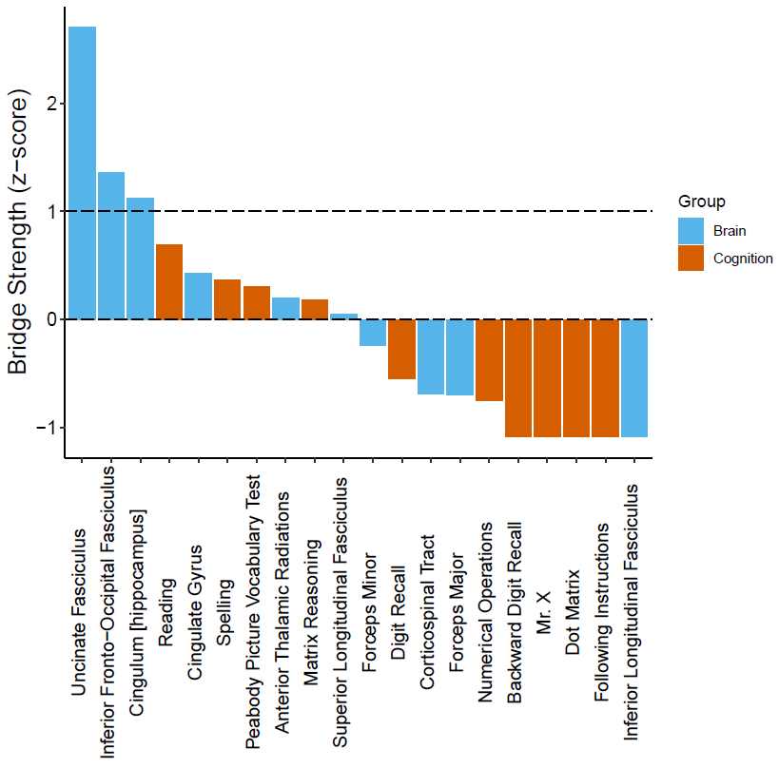
Cognition & GM
Bi-layer Network
Tri-layer Network
Cognition & WM
Bi-layer network

Slide 25
Part IV: Preliminary insights & cautions, and ways forward

Slide 26
Preliminary 'insights'?
Network models provide a method into examining the relations between the brain and cognition.
Future studies need to incorporate within-person (longitudinal) changes in network structure and function.
We need to move beyond simplistic classifications of cognitive and neural nodes.

Slide 27
Reasons to be cautious?
Since multilayer networks contain layers comprised from multiple data types (e.g., behavior and MRI), we must use appropriate methods to analyze them (see Blanken et. al., 2021)
It’s not enough to use fancy statistical models, we need better theories (Fried, 2020; Levenstein et al., 2020)
Before we make recommendations for interventions, we must first establish causality.

Slide 28
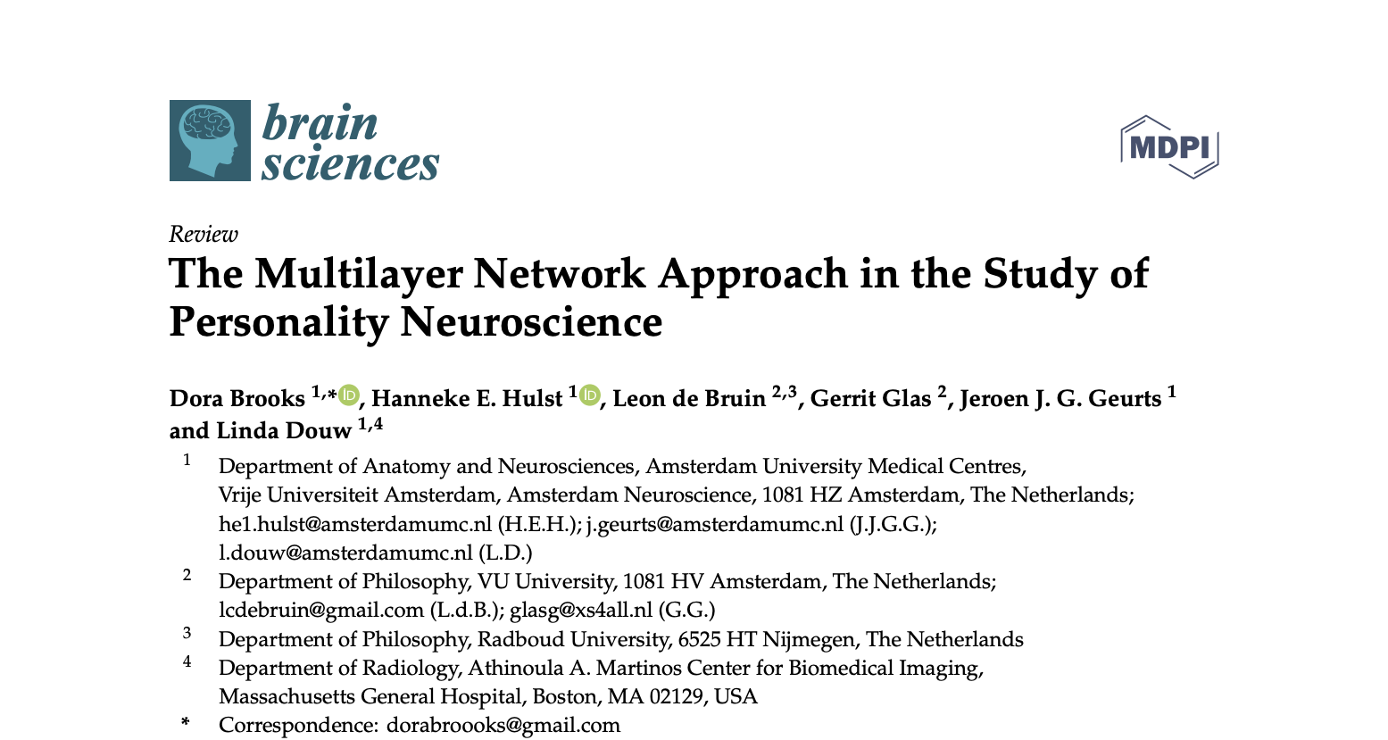
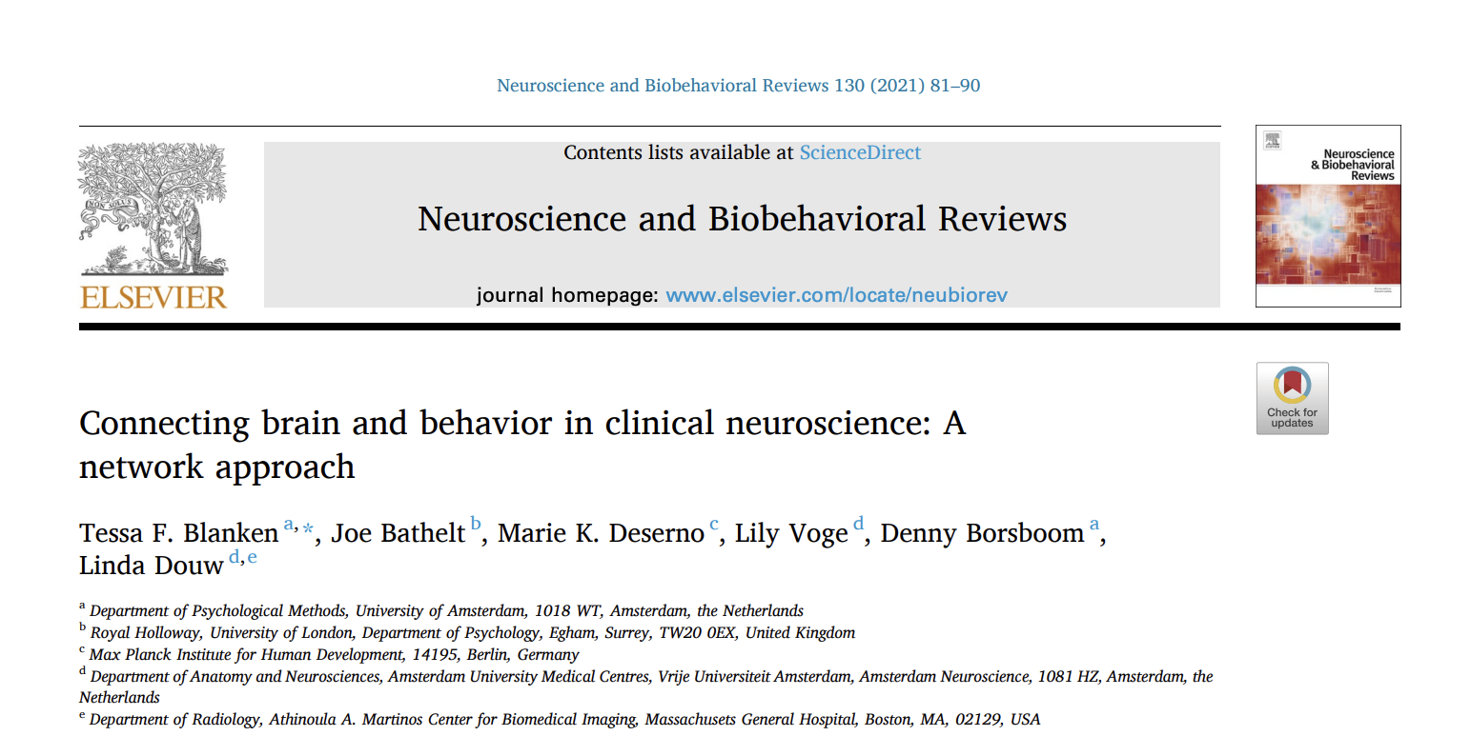
Ways forward?

Slide 29

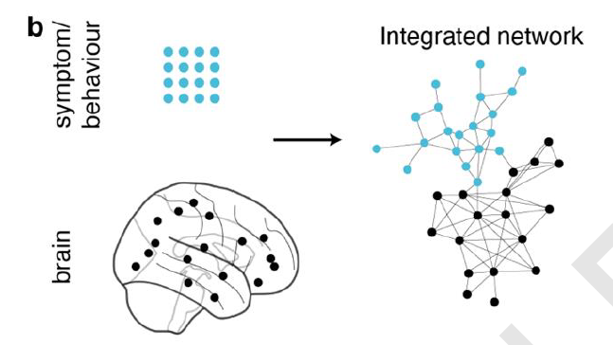
Bi-layer networks (exposome-brain)
Blanken et al., 2021
Simpson-Kent et al., 2021

Slide 30
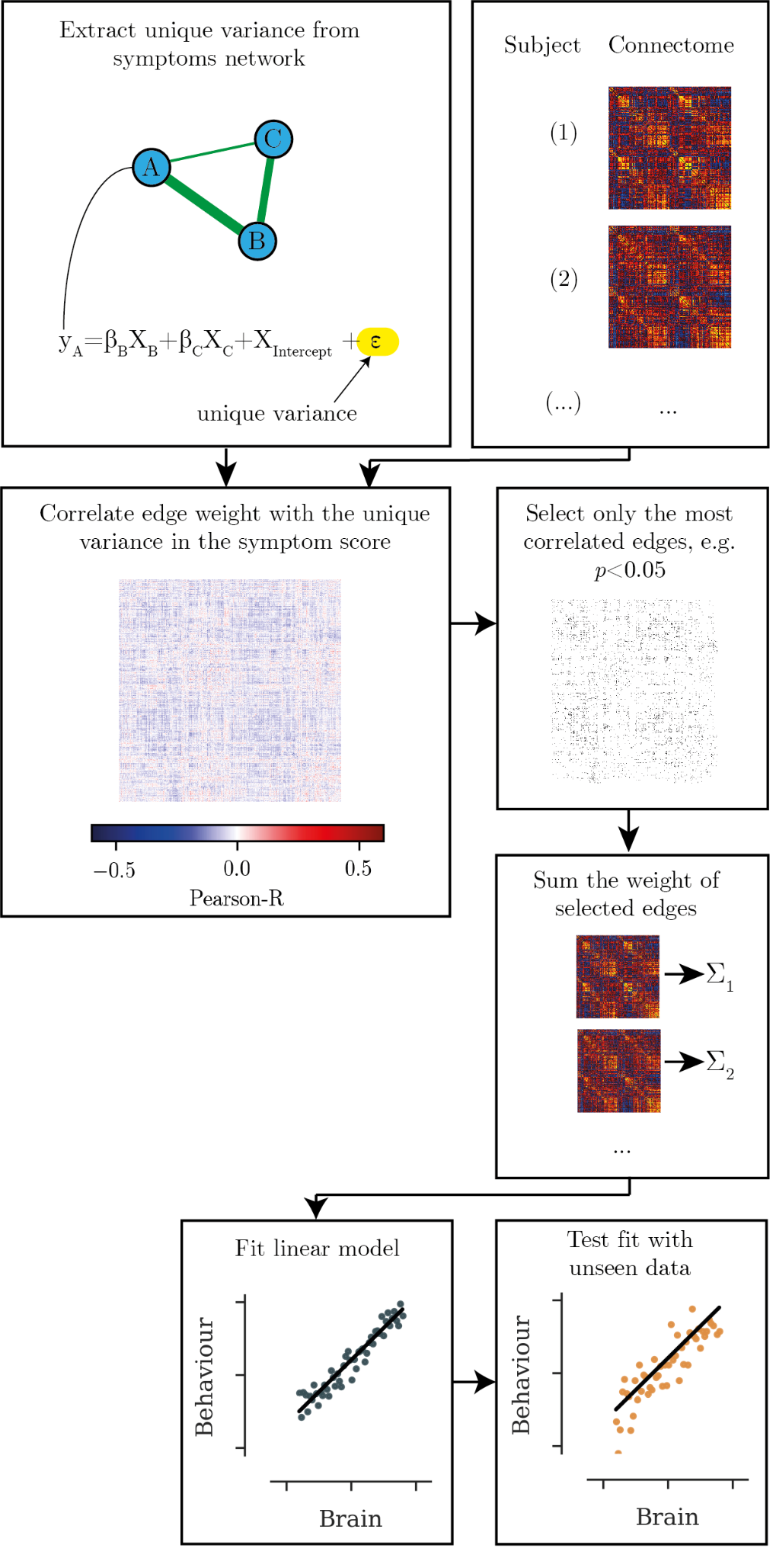
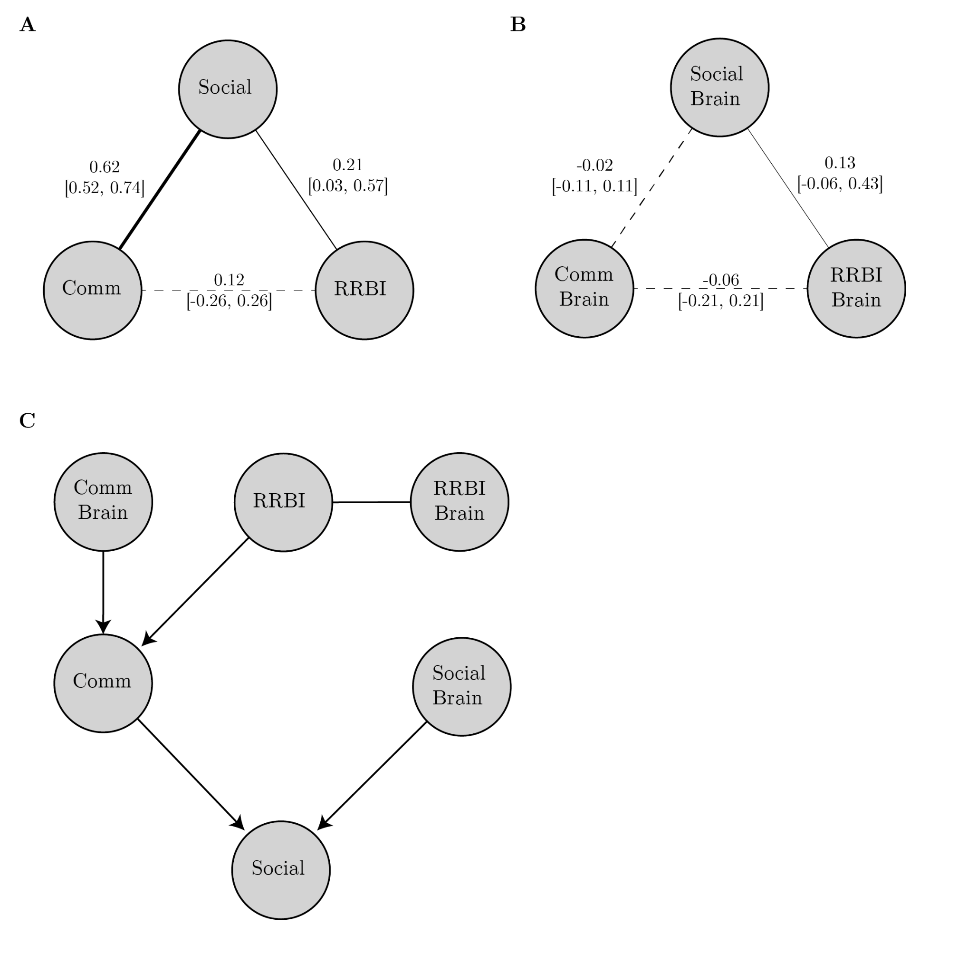
Network regression and directed graphs
Bathelt et al., 2020

Slide 31
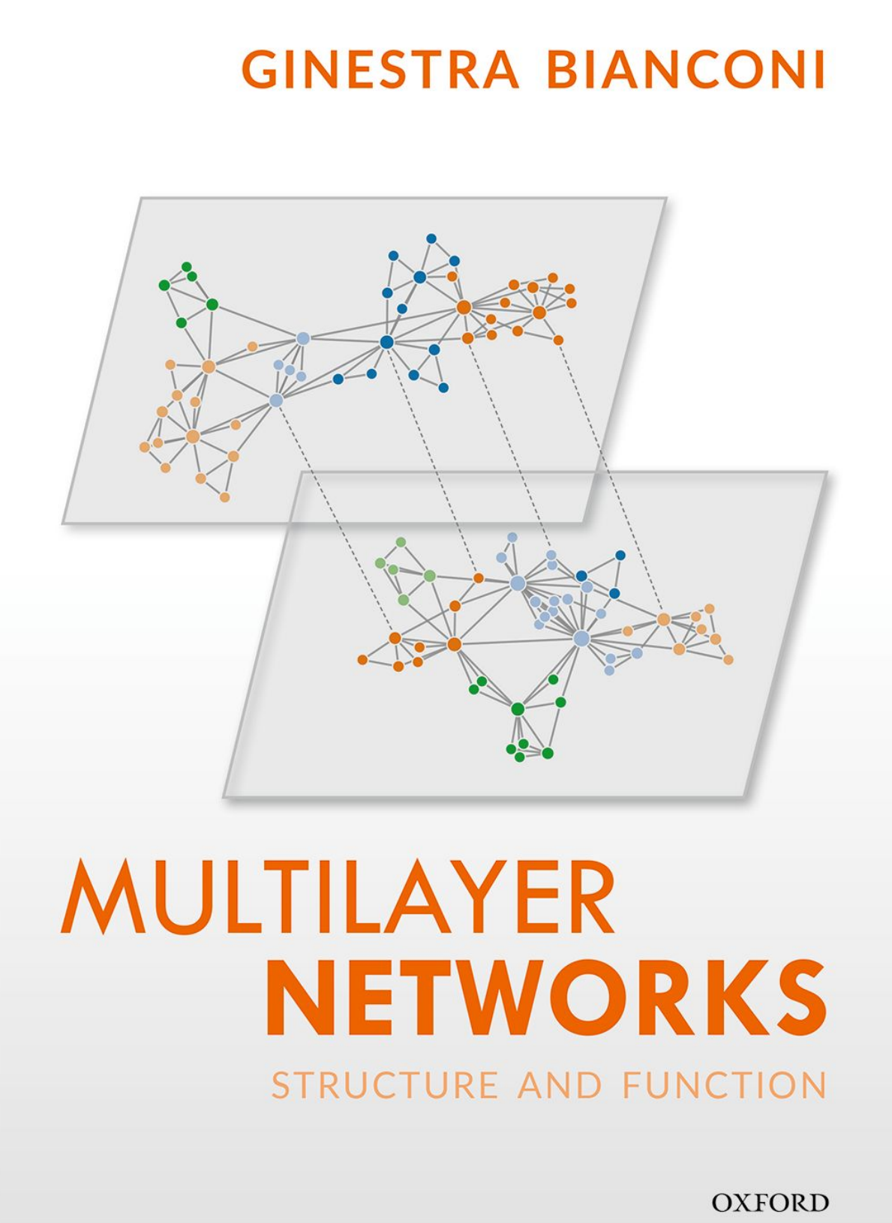

Ways forward?

Slide 32









Acknowledgments

Slide 33
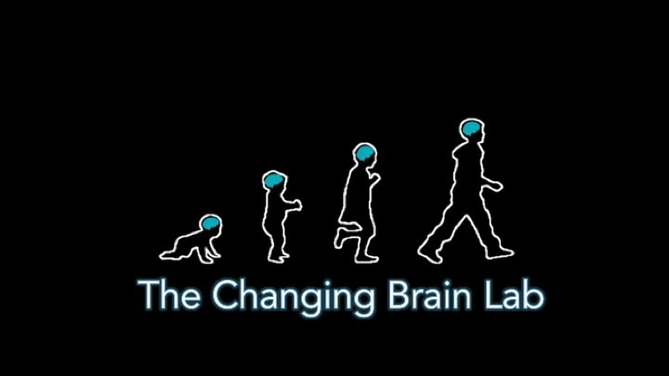
http://www.allysonmackey.com/

